Slide 1


MSC3182
SOCIAL ENTREPRENEURSHIP
Lesson 5
BLUE OCEAN STRATEGY

Slide 2
BLUE OCEAN STRATEGY - Definition
Wide cum deep unexplored space
'Blue Ocean Strategy is referred to a market for a product where there is no competition or very less competition.
Demand is created and not fought over.
This strategy revolves around searching for a business in which very few firms operate and where there is no pricing pressure.
The strategy aims to capture new demand, and to make competition irrelevant by introducing a product with superior features.
It helps the company in make huge profits as the product can be priced a little steep because of its unique features.

Slide 3
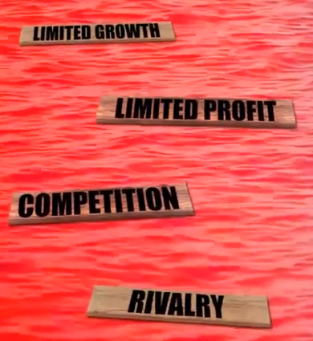
RED OCEAN STRATEGY
In the red oceans, industry boundaries are defined and accepted, and the competitive rules of the game are known.
Here, companies try to outperform their rivals to grab a greater share of existing demand.
As the market space gets crowded, prospects for profits and growth are reduced.
Products become commodities, and cutthroat competition turns the red ocean bloody.

Slide 4
RED OCEAN VERSUS BLUE OCEAN STRATEGY
Red Ocean Strategy | Blue Ocean Strategy
Compete in existing market space. | Create uncontested market space.
Beat the competition. | Make the competition irrelevant.
Exploit existing demand. | Create and capture new demand.
Make the value-cost trade-off. | Break the value-cost trade-off.
Align the whole system of a firm’s activities with its strategic choice of differentiation or low cost | Align the whole system of a firm’s activities in pursuit of differentiation and low cost.

Slide 5
BLUE OCEAN STRATEGY
Best way to grow is to LOOK FOR NEW MARKET SPACE which is not crowded rather to get a bigger share in the existing market space
As existing market gets crowded, products become similar to one another resulting in extreme competition and lesser profits.
The way out is to look for new customers by offering new a leap in value
Common mistake an entrepreneur make is to think that by adding a technological advancement to the product or service they can create an effective VALUE PROPOSITION

Slide 6
BLUE OCEAN STRATEGY
Even though new technology is often used, it is not the most important thing
Important is to IDENTIFY THE RIGHT MIX OF BENEFITS FOR YOUR PRODUCT AND SERVICE that would address the pain and create gain for your customer
Done well it will make the existing competition irrelevant for your venture

Slide 7


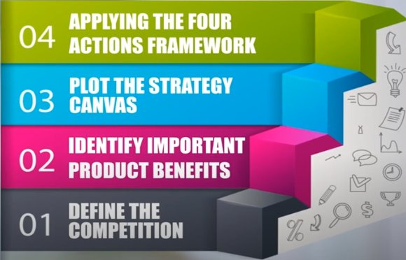
REFINING VALUE PROPOSITION

Slide 8

REFINING VALUE PROPOSITION
Identify 3 to 6 existing players who are your main competitors
Careful in identify the competitor who will be fighting for the same Niche
If too many competitors shortlist the one who sell more in your niche
Do not think that there is no competition at all in case your product is new to the market
There is always a substitute in the market
Eg. Front door lock that can unlocked with a mobile phone app using NFC tech this will be a new product with no competition in the market
But the competitor is from other digital lock or even a pad lock – all used for locking the door

Slide 9

REFINING VALUE PROPOSITION
Can be pain reliever, gain creator already identified
Shortlist 4 to 10 most important to the customers
Best way to merge the pain reliever, gain creator and

Slide 10






REFINING VALUE PROPOSITION
Plot the strategy of your competitors
Based on the gathered information, plot how the competitor fade against the benefits in the X axis
CUSTOMER PERCEPTION

Slide 11


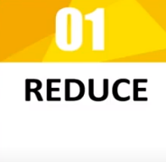
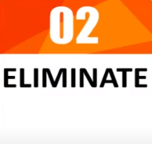
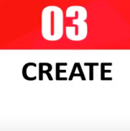
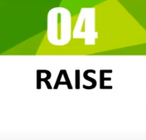
REFINING VALUE PROPOSITION
Helps to decide how to differentiate yourself from your competitor
Refers to benefits that can be reduced well below industry standards.
Refers to those benefits that the industry takes for granted and can be eliminated.
Refers to those benefits that can be created but the industry has never offered before.
Refers to benefits that can be raised well above the industry standards.

Slide 12
REFINING VALUE PROPOSITION
Not necessary to apply all the 4 actions
Only those actions make sense in your context

